Slide 1



INTRODUCTION TO SOFTWARE
DAY - 2

Slide 2
WHAT IS SOFTWARE
Software is a collection of programs and instructions used to operate computers and perform specific tasks.
Examples include: C, C++, Java, Python, HTML, etc.

Slide 3

CATEGORIES OF SOFTWARE
1. System Software -
Directly interacts with hardware.
Acts as a base for application software.
Example: Operating Systems (Windows, Linux, macOS, unix).
2. Application Software -
Designed for end users to perform specific tasks.
Examples: WhatsApp, Facebook, Banking Apps, Online Trading Platforms.

Slide 4
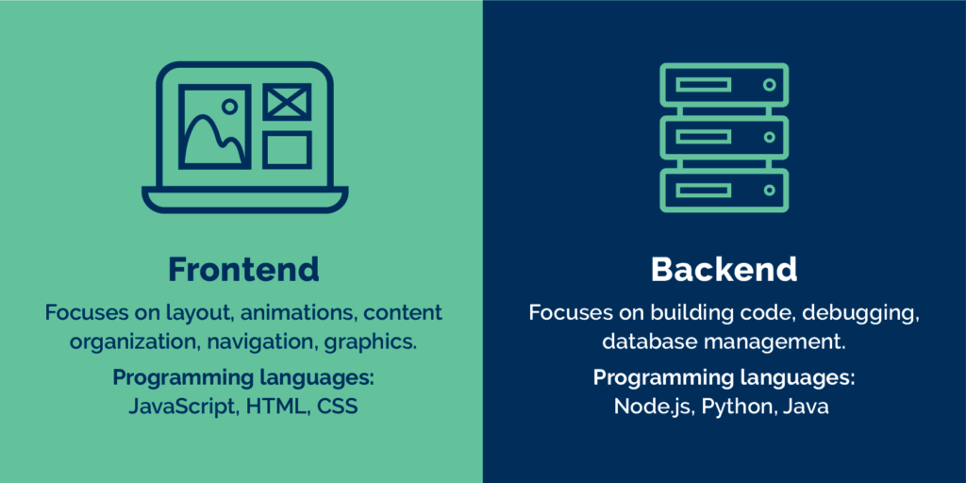
APPLICATION SOFTWARE

Slide 5
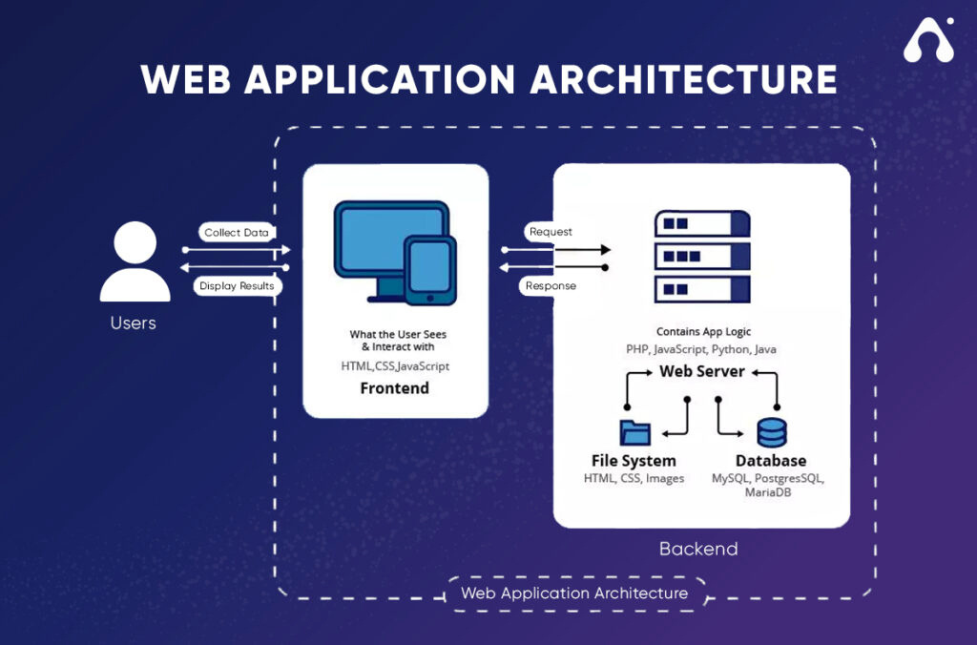
WEB APPLICATION ARCHITECTURE

Slide 6
WHAT IS AN OPERATING SYSTEM
An Operating System is:
A platform to run application software.
An interface between hardware and software.
It provides libraries to connect applications with hardware.
Every application must link to OS libraries to execute.
Can We Run Programs Without an OS?
Answer: No.
Only BIOS (Basic Input Output System) runs without OS.
BIOS is a chip-level program stored in ROM.
It is responsible for booting the Operating System.
Booting means loading OS from Hard Disk to RAM.

Slide 7
TYPES OF PROGRAMMING LANGUAGES
1.Low-Level Language -
System/Processor understandable.
Written in binary (machine code) like 10100101.
Example processors: 8085, 8086.
Also called Machine Language.
2.High-Level Language -
Human-readable, similar to English.
Easy to learn and write.
Examples: C, C++, Java, Python, HTML, Scala, .NET, etc.

Slide 8
HIGH-LEVEL TO LOW-LEVEL
HOW IT WORKS : -
Every high-level program must be converted to binary before running on hardware.
This conversion is done using :
Compiler or
Interpreter

Slide 9
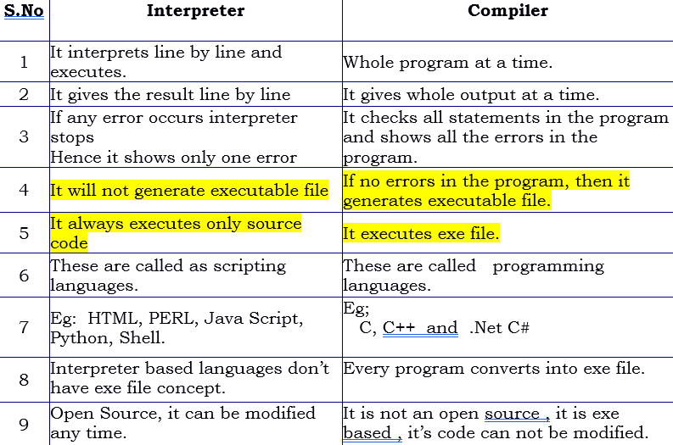
COMPILER VS INTERPRETER

